Slide 1
Private Deployment Models

Slide 2
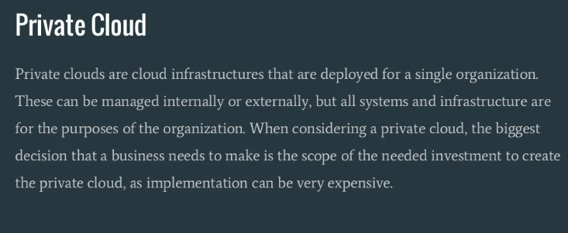

Slide 3
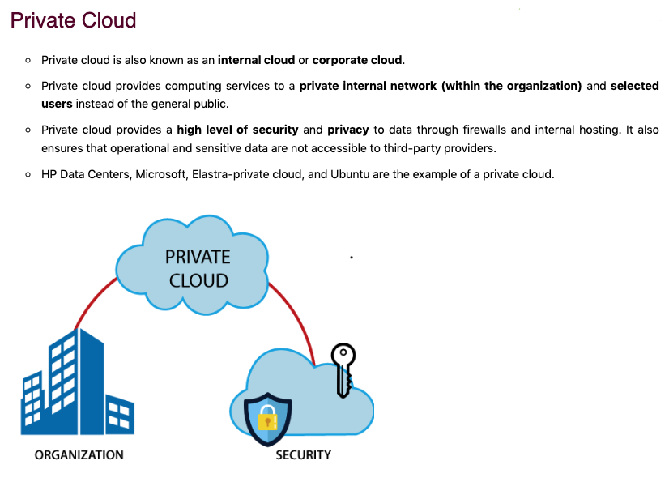

Slide 4
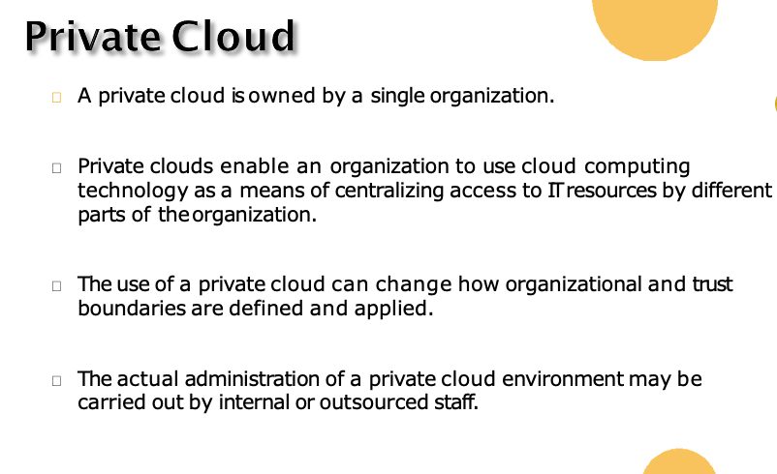

Slide 5
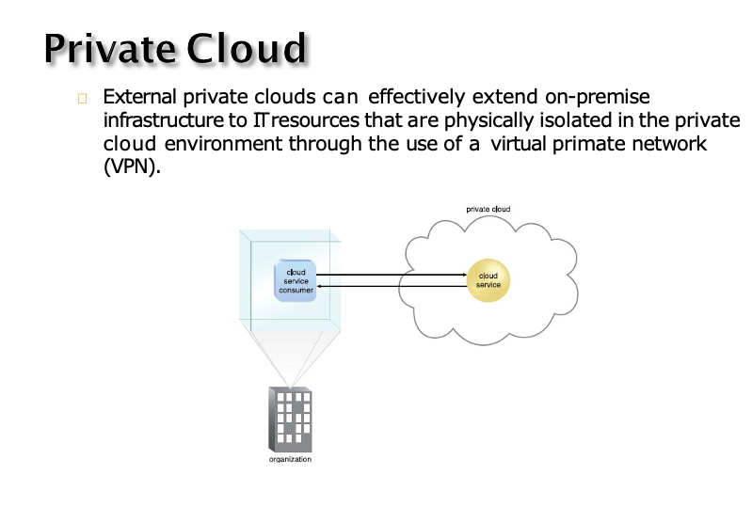

Slide 6
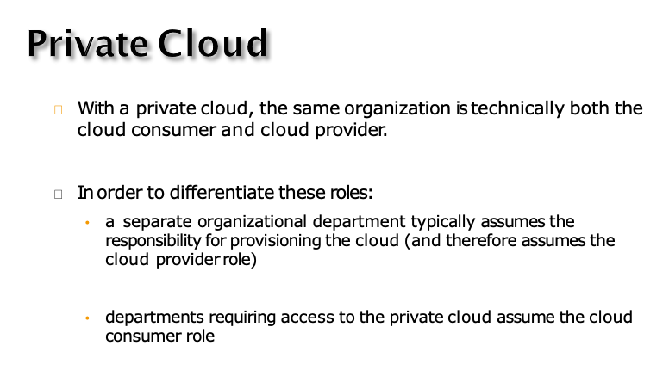

Slide 7
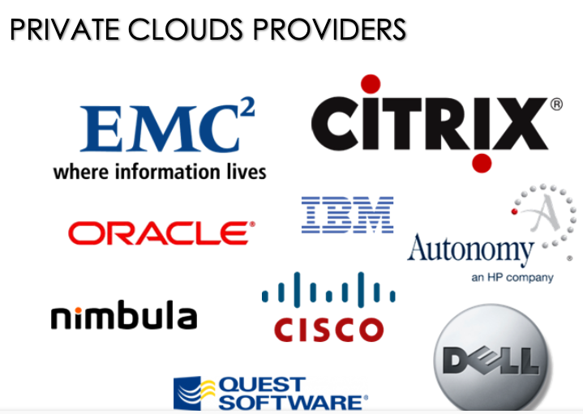

Slide 8
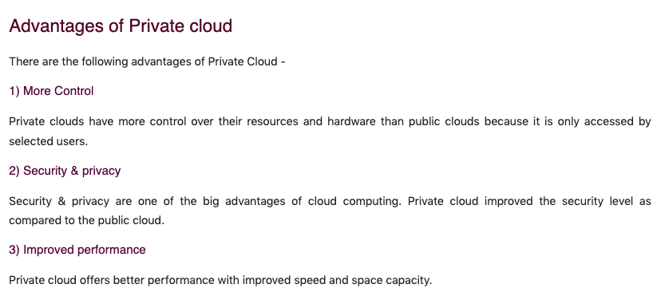

Slide 9
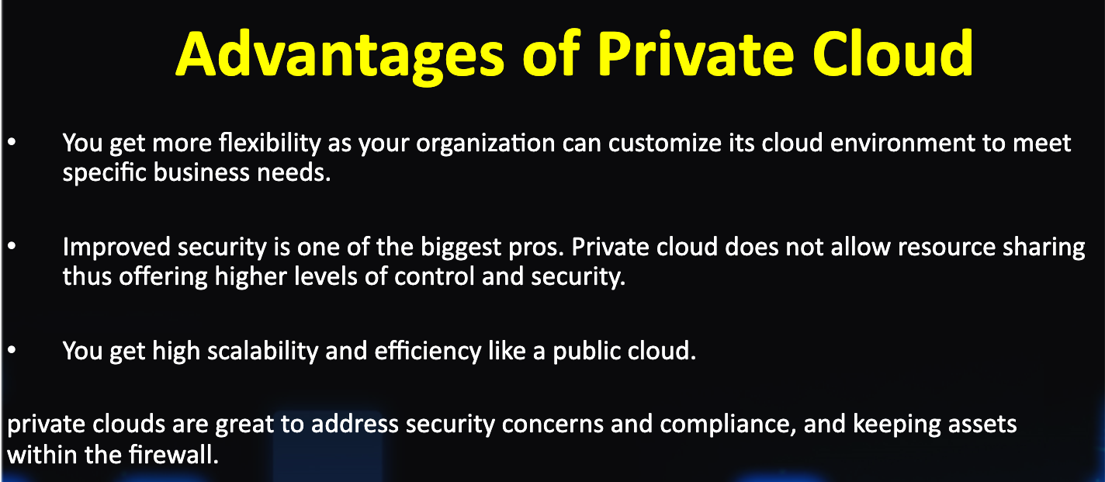

Slide 10
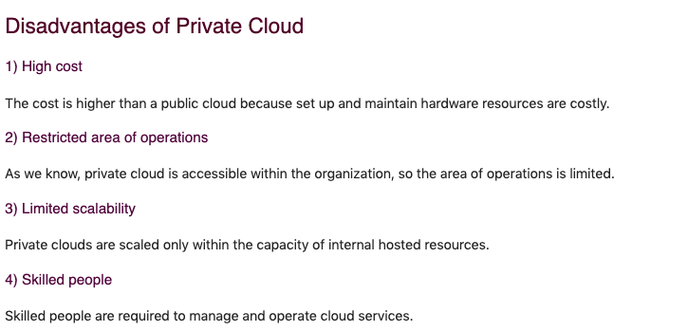

Slide 11
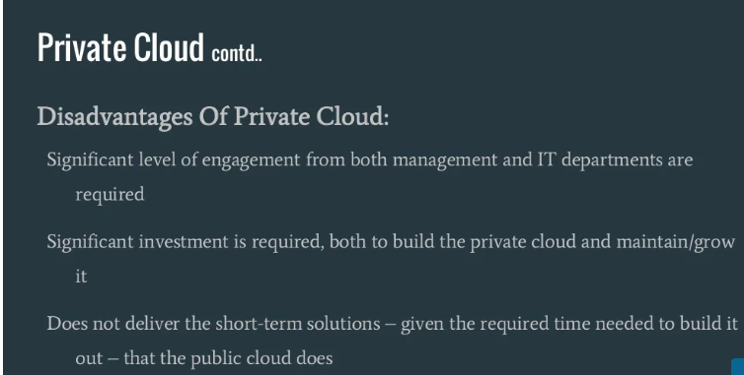

Slide 12
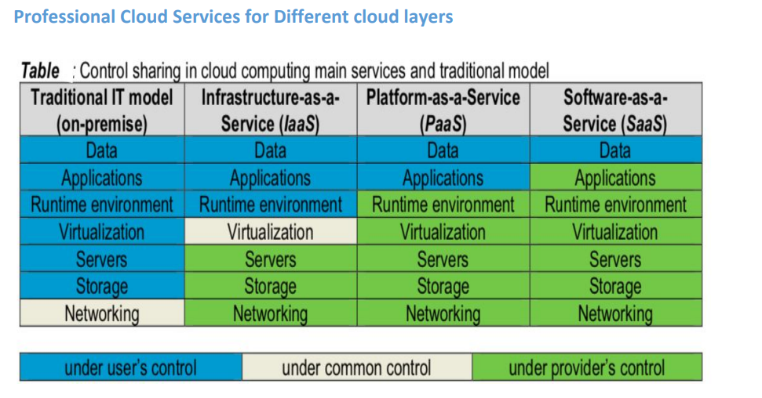

Slide 13
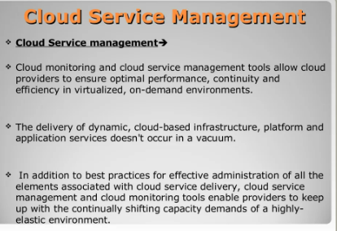

Slide 14
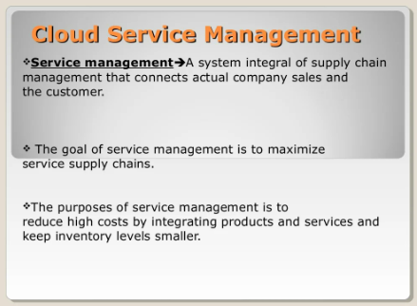

Slide 15
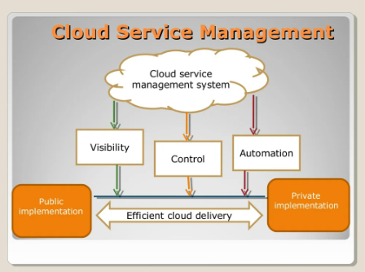

Slide 16
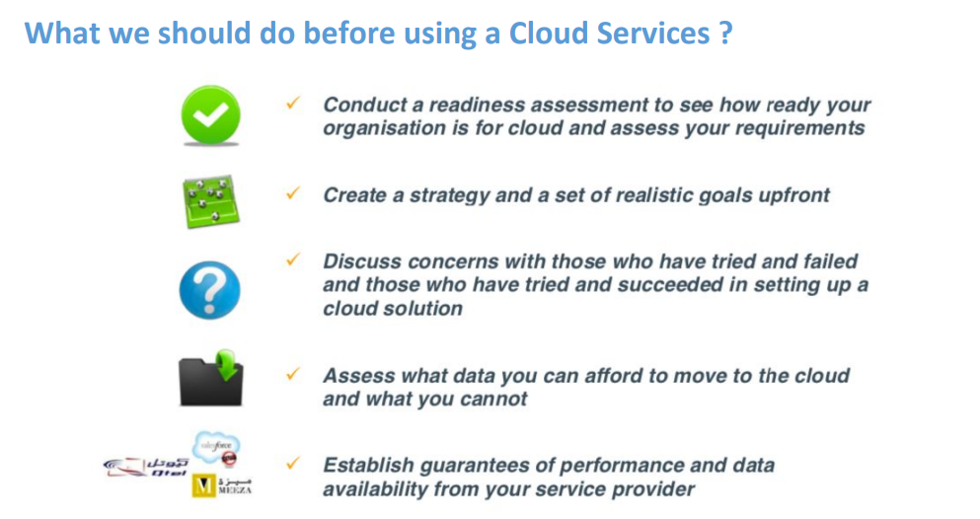

Slide 17
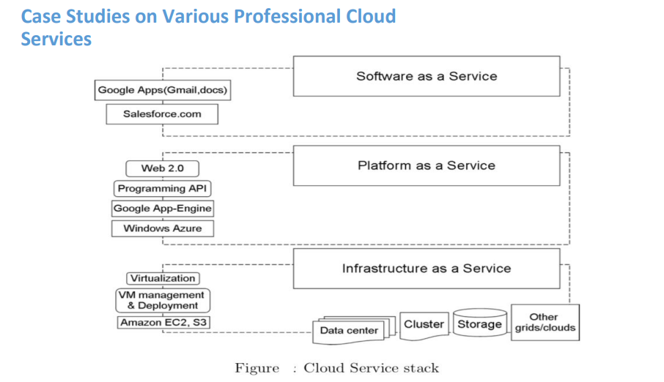

Slide 18
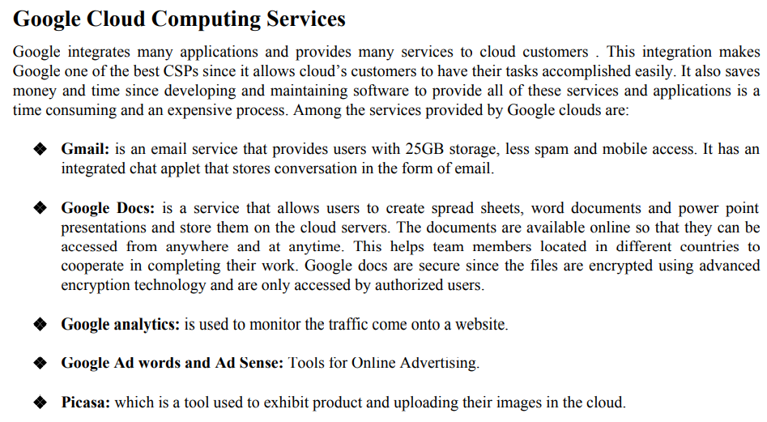

Slide 19
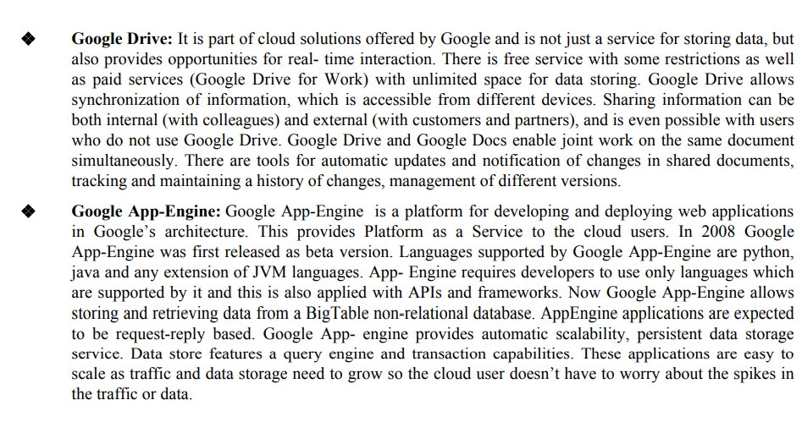

Slide 20
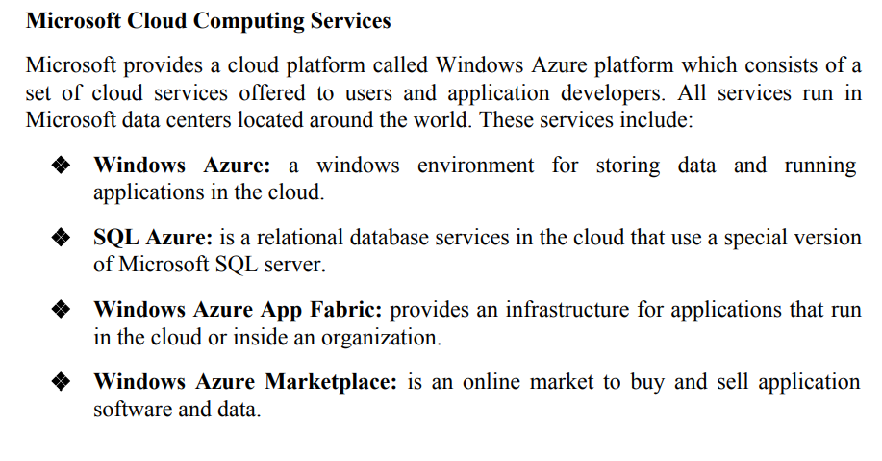

Slide 21
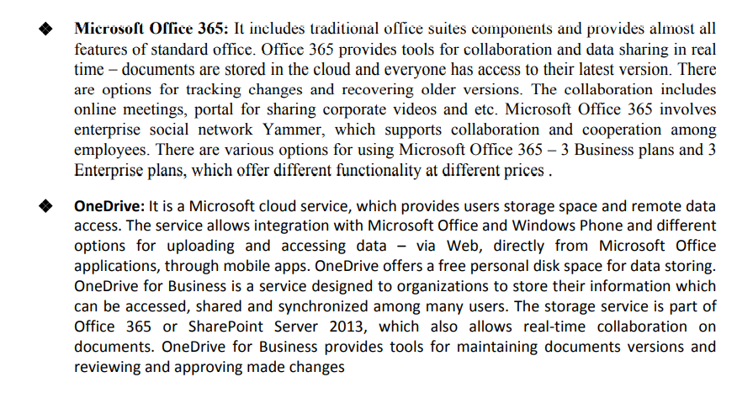

Slide 22
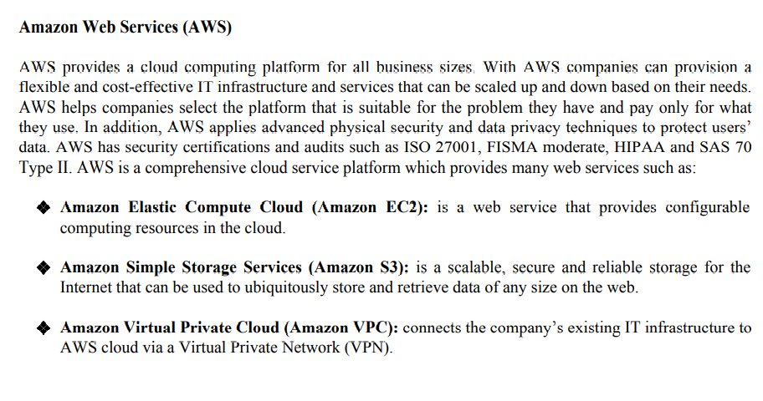

Slide 23
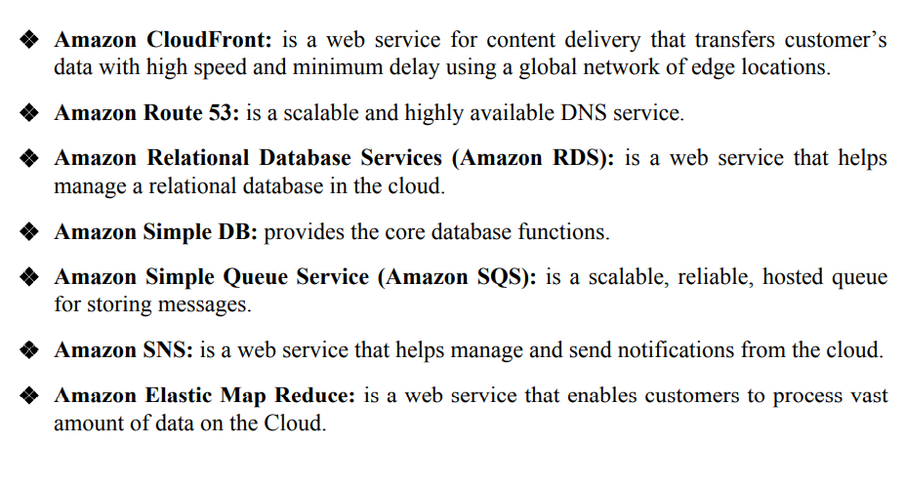

Slide 24
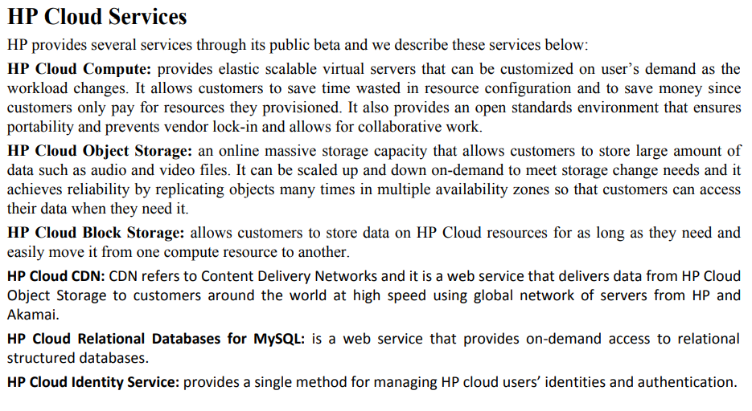

Slide 25
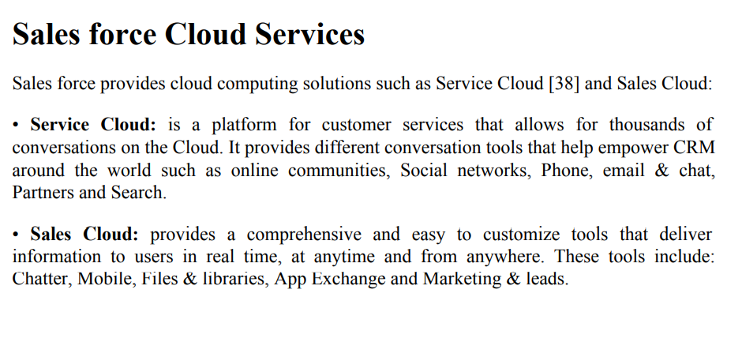

Slide 26
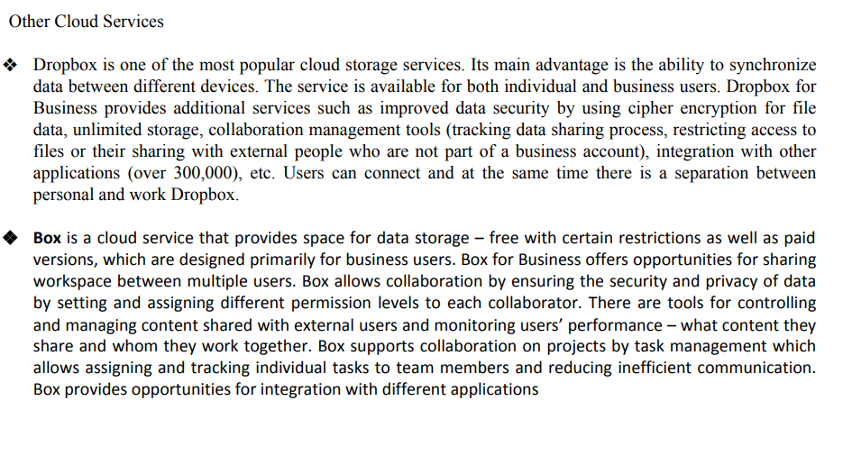

Slide 27
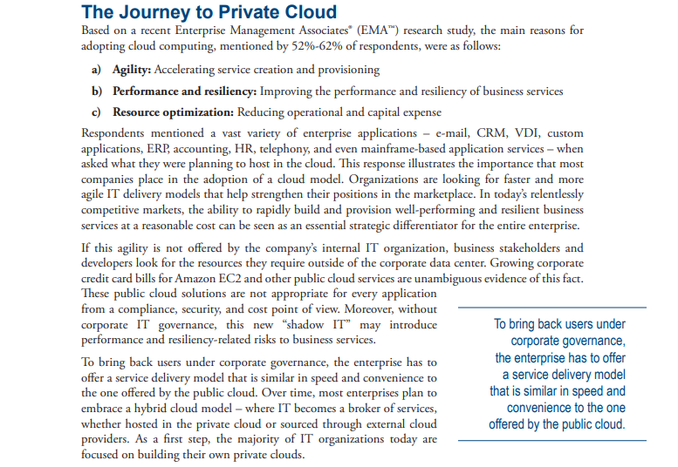

Slide 28
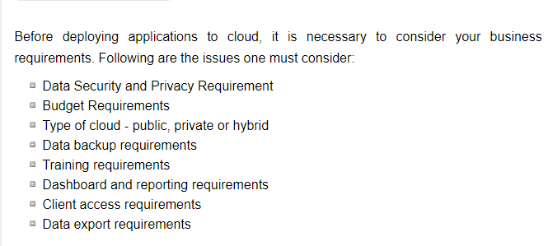
Different Steps to planning the cloud Strategies(1/6)

Slide 29
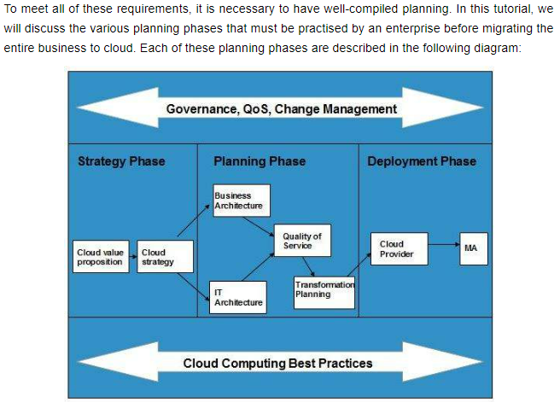
Different Steps to planning the cloud Strategies (2/6)

Slide 30
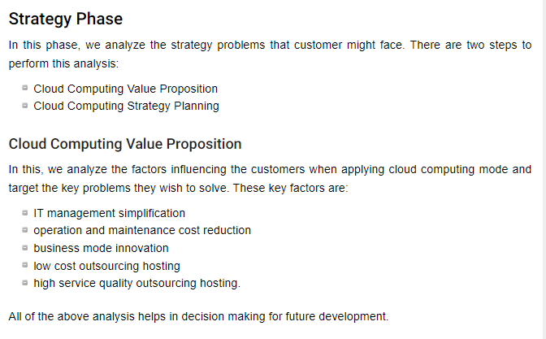
Different Steps to planning the cloud Strategies (3/6)

Slide 31
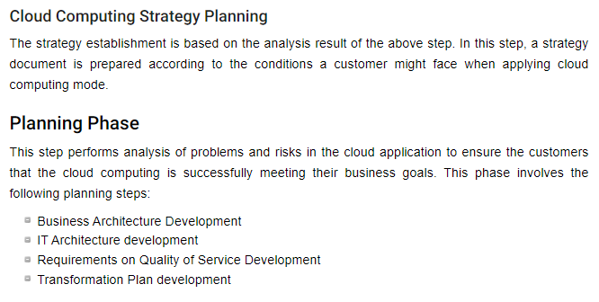
Different Steps to planning the cloud Strategies (4/6)

Slide 32
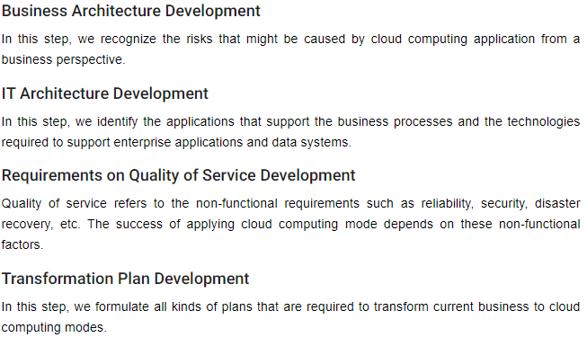
Different Steps to planning the cloud Strategies (5/6)

Slide 33
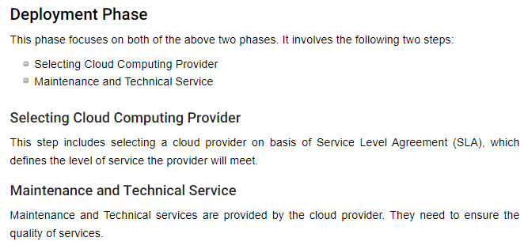
Different Steps to planning the cloud Strategies (6/6)

Slide 34
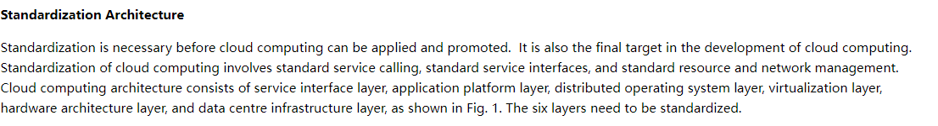
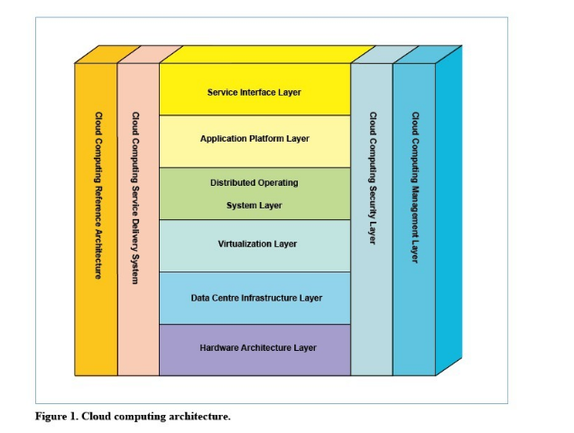
Cloud Computing Standardization

Slide 35
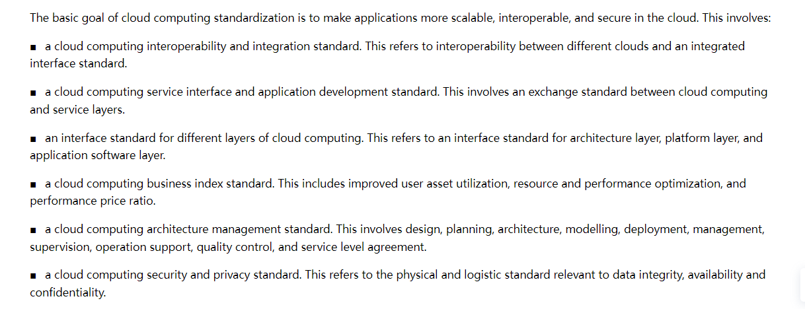
Cloud Computing Standardization

Slide 36
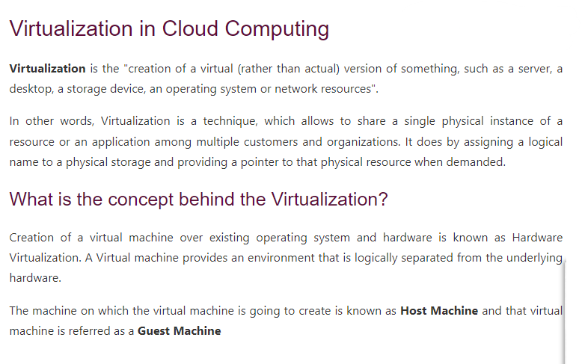

Slide 37
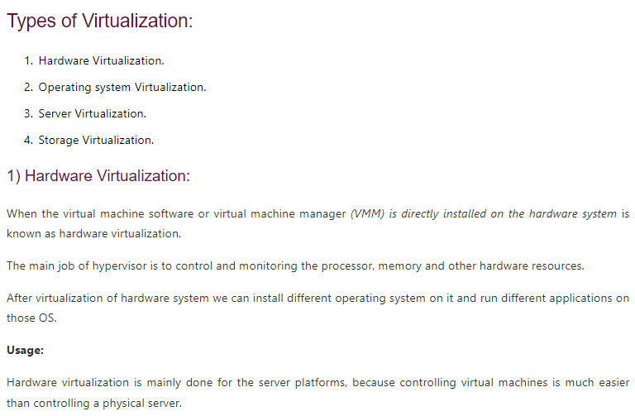

Slide 38
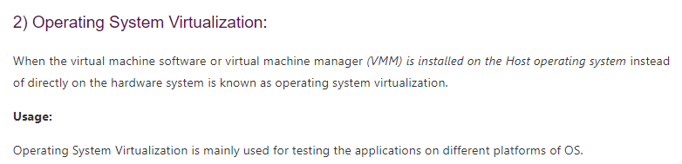
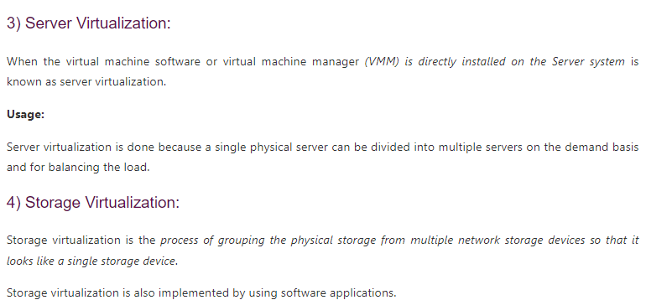
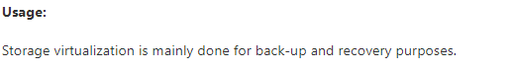

Slide 39
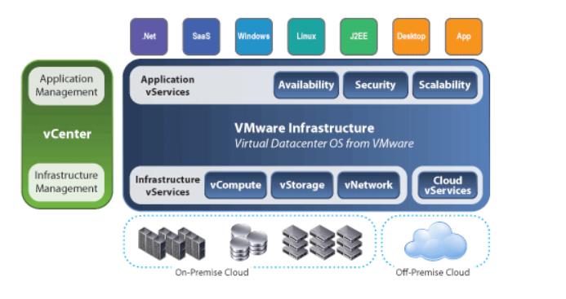
How does virtualization work in cloud computing?
Virtualization plays a very important role in cloud computing technology, normally in cloud computing, users share the data present in the clouds like applications, etc., but with the help of virtualization, users share the Infrastructure.
The main usage of Virtualization Technology is to provide the applications with the standard versions to their cloud users, suppose if the next version of that application is released, then the cloud provider has to provide the latest version to their cloud users, and practically it is possible because it is more expensive.
To overcome this problem, we use basically virtualization technology, By using virtualization, all servers and software application which is required by other cloud providers are maintained by third-party people, and the cloud providers have to pay the money on a monthly or annual basis.

Slide 40
What is cloud automation?
Cloud automation is a broad term that refers to processes and tools that reduce or eliminate manual efforts used to provision and manage cloud computing workloads and services. Organizations can apply cloud automation to private, public, and hybrid cloud environments.
Why use cloud automation?
Traditional deployment and operation of enterprise workloads is a time-consuming and manual process. This often involves repetitive tasks, such as the following:
sizing, provisioning, and configuring resources such as virtual machines (VMs);
establishing VM clusters and load balancing;
creating storage logical unit numbers (LUNs)
invoking virtual networks;
making the actual deployment; and
monitoring and managing availability and performance.
Although each of these repetitive and manual processes is effective, they are inefficient and often fraught with errors. These errors can lead to troubleshooting, which delays the workload's availability. They might also expose security vulnerabilities that can put the enterprise at risk.
With cloud automation, an organization eliminates these repetitive and manual processes to deploy and manage workloads. To achieve cloud automation, an IT team needs to use orchestration and automation tools that run on top of its virtualized environment

Slide 41
What are the types of cloud automation?
Automating various tasks in the cloud removes the repetition, inefficiency, and errors inherent in manual processes and intervention. Typical examples include the following:
Resource allocation. Autoscaling -- the ability to scale up and down the use of computing, memory, or networking resources to match demand -- is a core tenet of cloud computing. It provides elasticity in resource usage and enables the pay-as-you-go cloud cost model.
Configurations. Infrastructure configurations can be defined through templates and code and implemented automatically. In the cloud, opportunities for integration increase with associated cloud services.
Development and deployment. Continuous software development relies upon automation for various steps, from code scans and version control to testing and deployment.
Tagging. Assets can be tagged automatically based on specific criteria, context and conditions of operation.
Security. Cloud environments can be set up with automated security controls that enable or restrict access to apps or data, and scan for vulnerabilities and unusual performance levels.
Logging and monitoring. Cloud tools and functions can be set up to log all activity involving services and workloads in an environment. Monitoring filters can be set up to look for anomalies or unexpected events.

Slide 42
What are the benefits of cloud automation?
When implemented properly, cloud automation offers many benefits, such as the following:
it saves an IT team time and money;
it is faster, more secure, and more scalable than manually performing tasks;
it leads to fewer errors, as organizations can construct more predictable and reliable workflows; and
it contributes directly to better IT and corporate governance.
Cloud automation also enables IT teams, freed from repetitive and manual administrative tasks, to focus on higher-level work that more closely aligns with an organization's business needs, such as integrating higher-level cloud services or developing new product features.

Slide 43
What are the differences between cloud automation and cloud orchestration?
Cloud automation invokes various steps and processes to deploy and manage workloads in the cloud with minimal or no human intervention. Cloud orchestration describes how an administrator codifies and coordinates those automated tasks to occur at specific times and in specific sequences for specific purposes.
Cloud automation and orchestration are complementary and codependent. No orchestration process is entirely manual, and automated tasks are by nature part of an orchestration process.
Consider regularly scheduled data backup and recovery using the cloud. IT staff uses a tool natively from the cloud platform provider or a third party to plan a sequence of tasks based on logical events, such as time of day or discovery of error codes. This entire process from start to finish represents cloud orchestration. Individual parts of the backup process are automated, such as the actual data backup and notifications that the process was successful. If error codes are discovered, another orchestration of processes kicks off to alert staff to switch to take corrective action to repeat or manually complete the backup, and to troubleshoot what went wrong.

Slide 44
Cloud automation tools
There is no single cloud automation tool, platform or framework. A myriad of different tools and platforms can be used to automate one task or many, ranging from on-premises tools for private clouds to hosted services from public cloud providers.
Examples of automation services from public cloud providers include the following:
AWS Config, AWS CloudFormation, AWS EC2 Systems Manager;
Microsoft Azure Resource Manager, Azure Automation;
Google Cloud Composer, Cloud Deployment Manager; and
IBM Cloud Orchestrator.
Configuration management tools offer many cloud automation capabilities, particularly with an infrastructure-as-code setup. Examples include the following:
Red Hat Ansible
Puppet Enterprise
Chef Automate
Salt/SaltStack
HashiCorp Terraform
Other orchestration tool options include Broadcom (CA Technologies) Automic and Cloudify Orchestration Engine and Workflow Engine.
Many multi-cloud management vendors incorporate automation capabilities into their tools. Some prominent ones are:
VMware
CloudBolt
CloudSphere (Hypergrid)
Snow (Embotics)
Morpheus Data
Scalr
Flexera (RightScale)

Slide 45
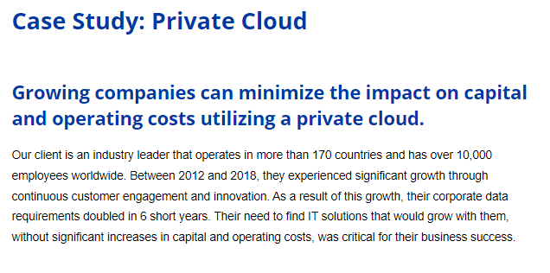

Slide 46
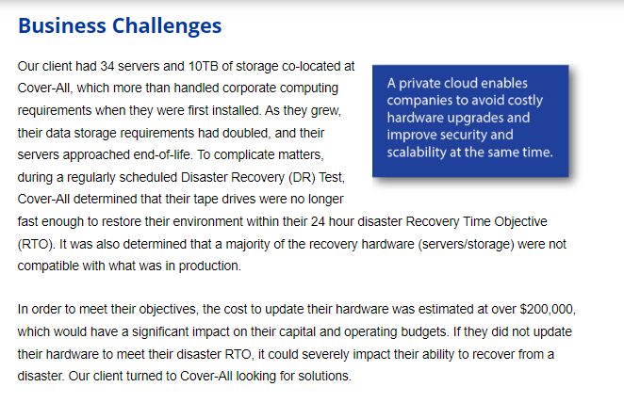
Case Study: Private Cloud

Slide 47
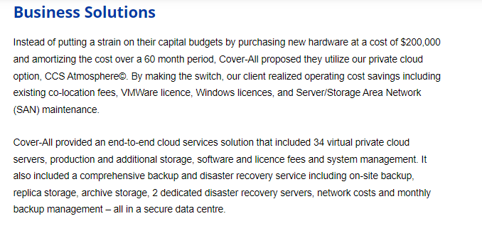
Case Study: Private Cloud

Slide 48
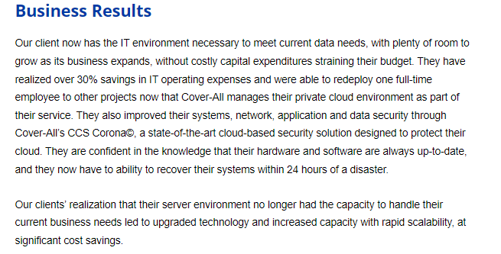
Case Study: Private Cloud

